Slide 1
Project 9 – Acoustic Awareness Enabler Concept Design Review ECE-457 Senior Design Project, Fall 2019
Sponsor:
Dr. Karen Payton
Advisor:
Dr. W. Vance McCollough
Members:
Drew Martins – Team Lead, Programmer
Jared Alves – Programming and Troubleshooting
Michael Benker – Electrical Design
Ryan Dumont – Data Analyst
Stephen Felix – Data Collection, Writer

Slide 2
Customer Requirements
# | Customer Requirement
1 | Power source must be self-contained and have a life of 8 hours.
2 | Must have a 3.5mm female audio jack for the input and output.
3 | Must have 3 different levels of interruption noise sensitivity (High, Medium and Low sensitivity).
4 | When interruption is detected, the volume of the noise going through users' headphones must be muted or lowered.
5 | Must be able to distinguish between ambient and interrupt with a 1% false interrupt detection rate.
6 | Must have a reset button to restart the audio
7 | Separate audio cable between device and audio source.

Slide 3
Engineering Requirements
Requirement | Customer Requirements | Engineering Requirements | Justification/Comments | Test Methods
1 | Self-containment of power source (rechargeable) and battery life of 8 hours | 1.1 8 hours of power supplied to device | Device needs an independent power source because it is not being supplied by the audio source | Lab testing confirming power usage of the device
2 | 3.5mm audio jack for input and output | 2.1 Audio Source Input 3.5mm | The input is for the device to be connected to the phone or audio source. The output is connected to a pair of headphones. In between the input (L/R) and output (L/R) is a digital potentiometer/switch that reduces the volume of the audio source to the output. | Examine the Standards for the 3.5mm headphone jack and use the information to design the input and output.
 |  | 2.2 Audio Source output 3.5mm
 |  | 2.3 I/O interface – digital potentiometer/switch
3 | Must have 3 different levels of interruption noise sensitivity (High, Medium and Low sensitivity) | 3.1 Must create MATLAB programs to take in data to provide averages and standard deviations to base sensitivity levels on | The user will select a sensitivity level through the interface buttons. The sensitivity levels will be relative to the ambient level measured by the device. | MATLAB data processing will be used to generate sensitivity levels relative to ambient
 |  | 3.2 Three separate sensitivity buttons

Slide 4
Engineering Requirements Continued
Requirement | Customer Requirements | Engineering Requirements | Justification/ Comments | Test Methods
4 | When interruption is detected, the volume of the noise going through users' headphones must be muted or lowered | 4.1 Use of potentiometers/switches to attenuate audio | Potentiometers or switches? | Lab testing of potentiometers/switches for reduction of audio signal
5 | Must be able to distinguish between ambient and interrupt with a 1% false interrupt detection rate | 5.1 Comparison of data sets will show a range of ambient dB levels that will yield a 1% false detection rate or better | Ensures reliability. Preference is for audio to continue uninterrupted. Failure can be caused by failing to attenuate audio or device interprets a deviance in ambient noise as an interrupt | MATLAB plots show curves of ambient data and interrupts which show overlapping for possible false interrupt detection
 |  | 5.2 Lowest Ambient Noise of 30 dB based on ANSI standards
 |  | 5.3 Must have 100 Hz Sampling frequency to detect averages in sound (not reconstructing signal)
 |  | 5.4 Need a sound level detector
6 | Must have a reset button to restart audio | 6.1 Physical reset button will be present on Acoustic Awareness enabler to start the resetting of audio signal. | Need to resume original audio after it is attenuated | Lab testing for potentiometers for increase of audio signal
 |  | 6.2 Use of potentiometers/switches to resume audio after reset button has been pressed.
 |  | 6.3 Button will recalibrate device and will delay further interrupts for 20 seconds while gathering data
7 | Separate audio cable between device and audio source | (Requires no further engineering, will be included with final product) | Connects device to audio source, reduces overall form factor. | Cable is used in lab testing

Slide 5
Constraints
Portability – device needs to be carried with a set of headphones
Form Factor – device should be roughly the size of a stack of ID cards (dependent on battery size).
Availability of Components
Budget as defined by customer
Time Constraints: Project must be completed by Spring 2020.
Standards
IEEE Code of Ethics
Microcontroller/Coding – ATMega32pb, C Programming, AVR, C++
​ 3.5mm Auxiliary Port
• Sound Level - IEC 652 TYPE2 and ANSI S1.4 TYPE2
I²C and SPI Standards: 7-Bit Addressing

Slide 6
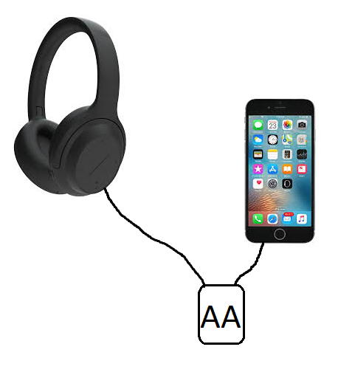
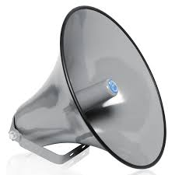
HIGH LEVEL DESIGN
Device Functions & Settings
Acoustic Awareness Enabler
OFF: Audio continues irrespective of outside sound.
ON: Audio to the headphones is turned off after an "interrupt" sound is detected that falls outside of the ambient sound level. The threshold for the interrupt sound is determined by the sensitivity setting.
High Sensitivity: Audio stops at the quietest of sounds above the ambient level.
Medium Sensitivity: Audio stops after detecting moderate interrupt sounds.
Low Sensitivity: Audio stops only after detecting sounds at a level far out of the ambient range.
Reset: Resumes audio after audio is attenuated.
Diagram shows audio source being attenuated only after a loud interrupt, indicating a low sensitivity. "Loud", "medium" or "quiet" interrupts defined as relative to the ambient level.
Medium
Stopping audio! Pay attention!
Setting: Low
Loud
Waiting...
Quiet

Slide 7
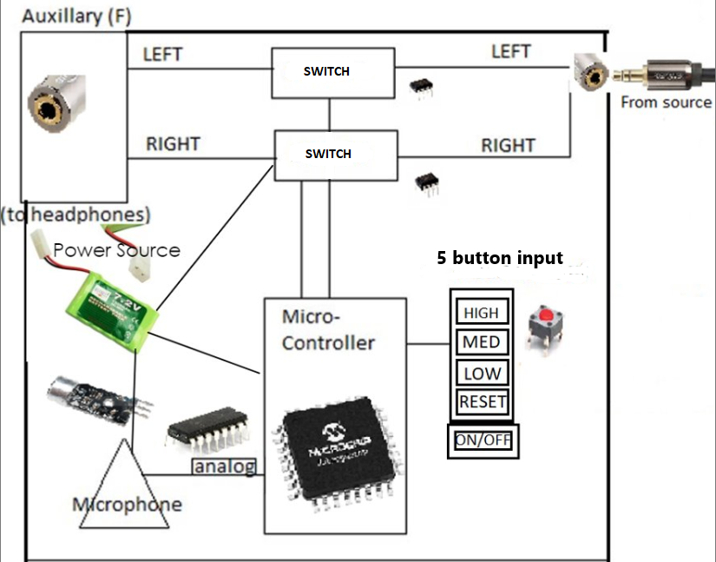
Concept design
Auxiliary ports (x2 F), M-M Aux. Cable
Audio input for left and right traces.
Digital Potentiometers/Switches (x2)
Reduce volume output on left and right traces via interface with microcontroller.
Input controls (buttons) (x4)
Achieves customer requirements by allowing for our 3 threshold level selections.
Microphone/Sound Level Sensor
Measuring from 30 dB to 90 dB
Analog interface (op-amp) corrects voltage output range to interface with Microcontroller (max input voltage: V_{CC}).
Microcontroller (choice: Atmega328PB)
Takes data from Microphone/Sound Level Detector and calculates an ambient average level, which is compared with a 2 second average. Levels are compared and, using a threshold function (discussed later in presentation), it is determined whether the audio is stopped.
Interfaces with digipots/switches to control audio volume.
Interfaces with buttons for sensitivity levels, reset and ON/OFF selection.
Power Source

Slide 8
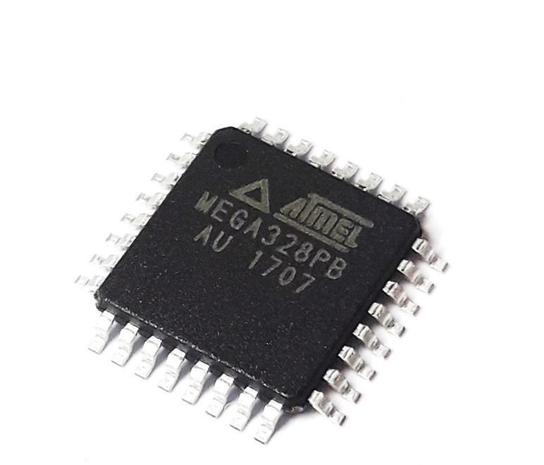
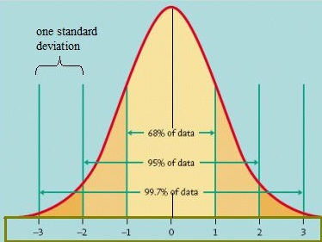
Overview of the two alternative approaches being considered
Threshold Calculation Methods:
MICROCONTROLLERS:
ATMega328PB
8-bit AVR Architecture
ATSAMD21G18
Larger ADC
Larger RAM size
32-bit ARM Architecture
ATMega2560
Larger RAM size
8-bit AVR Architecture
Static dB Level
Fixed dB Threshold levels for each setting.
dB Interrupt-Factor Method
Interrupt threshold levels are factors of the ambient. Example: Low Sensitivity Threshold = 2.33*Ambient (by trial and error).
Data-Analysis Method
Interrupt threshold levels are calculated as functions of the ambient level, based on acquired data.

Slide 9
Microcontroller selection
Criteria | Weight | Reasoning | Alternatives
 |  |  | ATmega328PB |  | ATSAMD21G18 |  | ATmega2560
Cost & Availability | W = 0.0 | Part is disqualified if outrageously expensive or unavailable. | $1.41, Av. | - | $3.22, Av. | - | $12.35, Av. | -
ADC Resolution | W = 0.2 | A Higher ADC Resolution means a more precise and a larger measurement range. | 10-bits | 3 | 14-bits | 5 | 10-bits | 3
Timers | W = 0.1 | A timer is invoked for each sample the microphone takes and a timer to average the sampled data. | 2x8-bit 3x16-bit | 5 | 5x16-bit | 5 | 2x8-bit 4x16-bit | 5
Power Requirements | W = 0.2 | Power requirements depends on whether we can run the CPU in low power mode and the flexibility of the CPU's power usage itself. | 1.8V- 5.5V | 5 | 1.62V - 3.63V | 3 | 4.5V - 5.5V | 2
Memory (RAM) | W = 0.2 | More memory allows us to store more sample data to process. | 2 kB | 3 | 256 kB | 5 | 256 kB | 5
Ease of Use | W = 0.3 | Prior experience with using the CPU or it's architecture | 8-bit AVR Used Before | 5 | 32-bit ARM Not Used | 1 | 8-bit AVR Not Used | 4
Total Score | ΣW = 1 |  |  | 4.2 |  | 3.4 |  | 3.7

Slide 10
Component selection: Microcontroller: Atmega328PB
The ATMega328PB provides the greatest cost benefit and provides a great range of acceptable voltage output. Another appeal of the device is the familiarity for team members and the cost of development boards.
Because the microcontroller has a built-in ADC with a sufficient resolution, this microcontroller can store and analyze an efficient amount of ambient noise data to allow us to formulate our threshold parameters. The ATMega328PB can run in low power mode, this helps us target the minimum battery life

Slide 11

Threshold Calculation Methods
Method | Description | Advantages | Disadvantages
"Static dB Level" | Interrupt levels are fixed sound pressure levels: X dB, Y dB and Z dB | Easiest to implement | Does not vary according to ambient level. Experience may be limited to certain situations.
"dB Interrupt-Factor Method" | Interrupt levels are a factor of ambient sound level, ex. X dB = (ambient)*1.5 (factor levels TBD upon testing) | Easier to implement. Method may work better than the "Static dB Level" approach | This option will require a lot of testing and may be inaccurate if not tuned.
"Data-Analysis Method" | Data is collected for numerous locations of varying sound level. Data collected, simulated in MATLAB to determine a "threshold function" | Highly accurate. Preferred method of the customer. Doesn't require more funds. Theoretically achieves 1% false alarm rate (customer requirement). | Data collection may take some time. Requires MATLAB simulations.

Slide 12
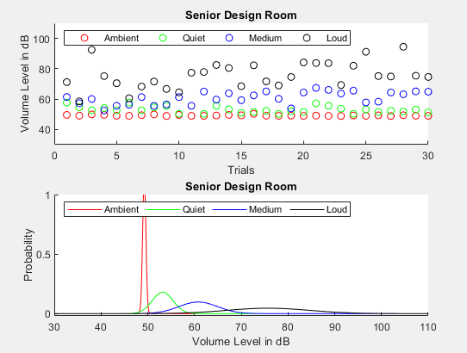
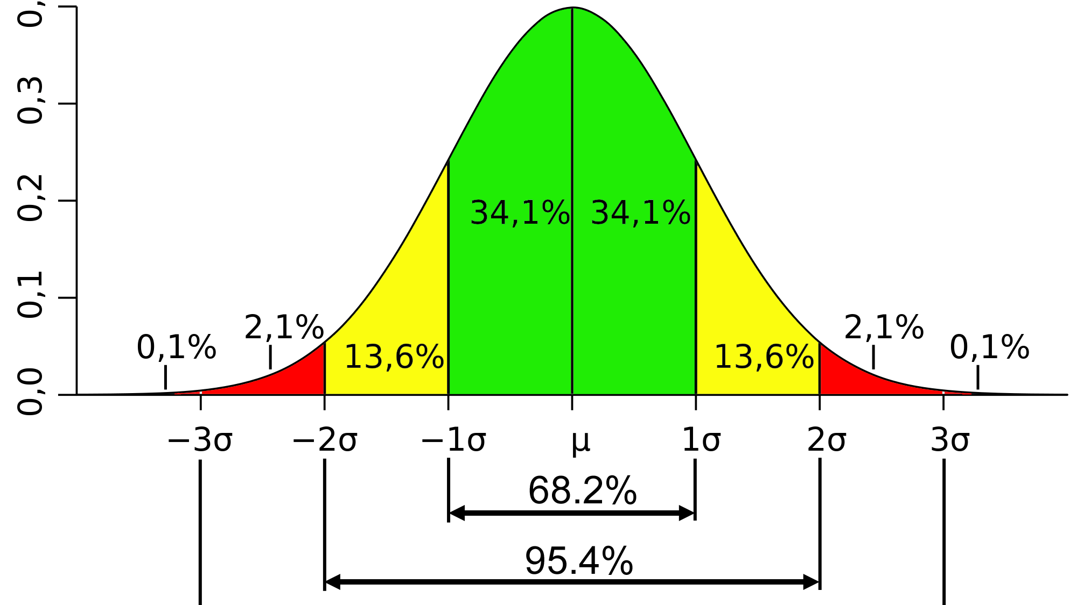
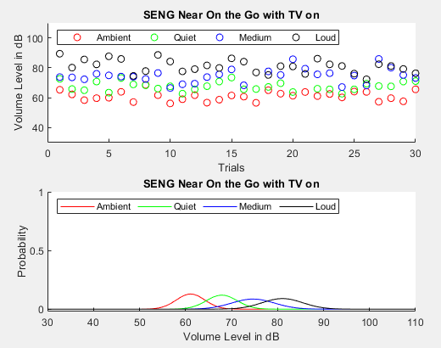
Selected Approach: Threshold Data-Analysis Method
Current Progress:
Averages, Standard Deviations are calculated in MATLAB for each location and level.
Gaussian plot and scatterplot of data are complete.
Plot of interrupt level as function of ambient.
What's Next:
Curve-fitting to develop formula to determine necessary immediate sound level (average over ~2 seconds) to cause an interrupt, given data on previous ~20 seconds (ambient).
Collecting more data to improve accuracy of formula.
Implementation of formula in microcontroller.

Slide 13
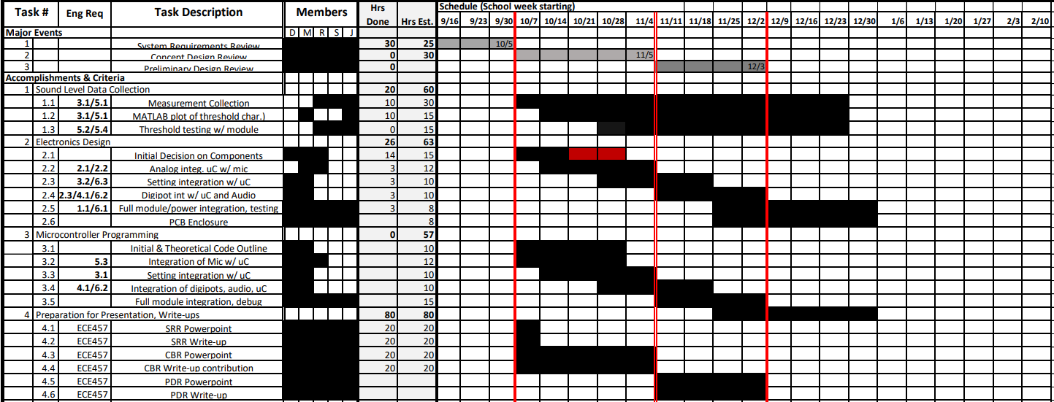
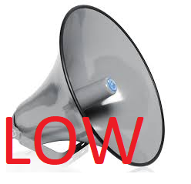
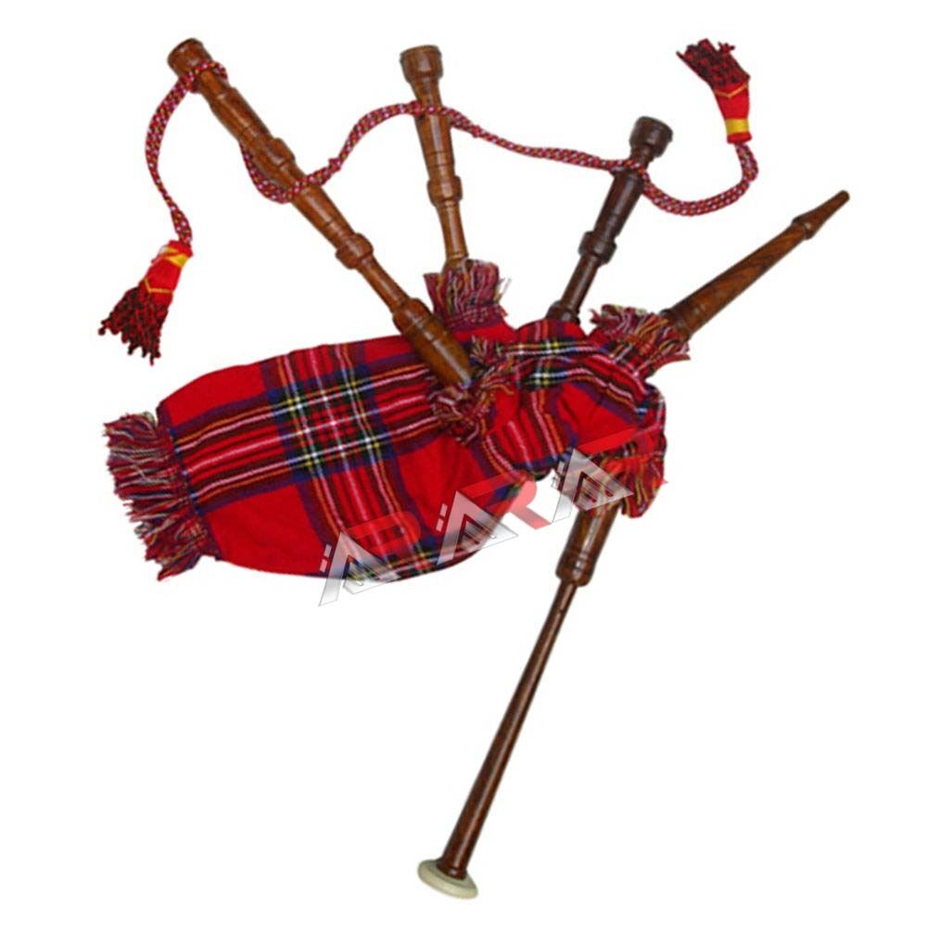

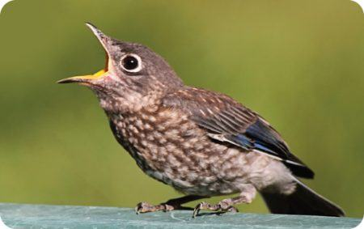

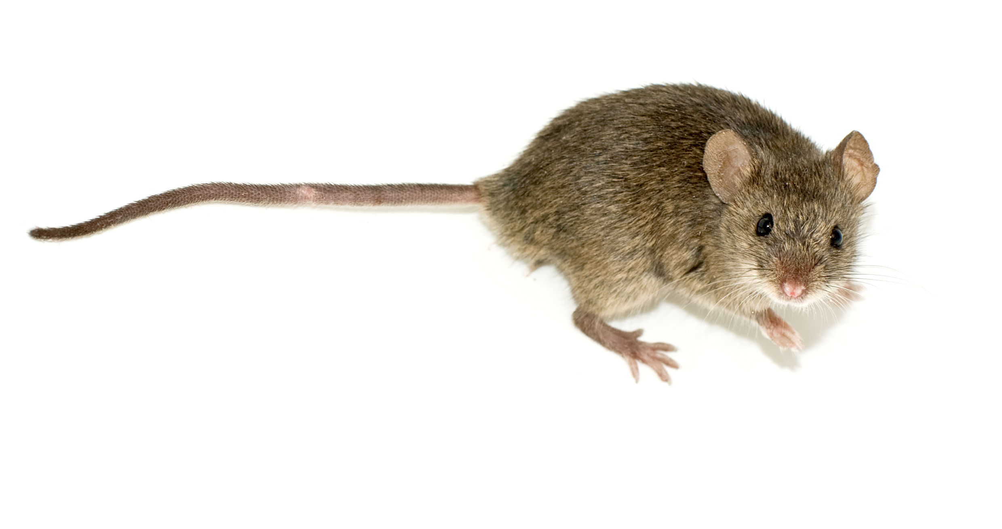




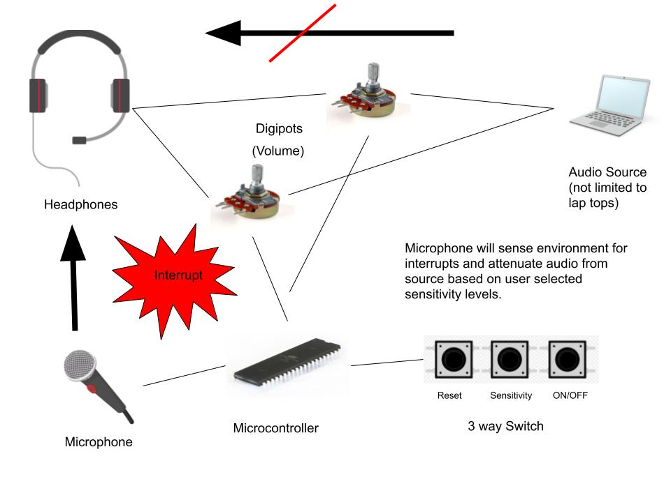
GANTT Chart Schedule
SRR CDR PDR

Slide 14
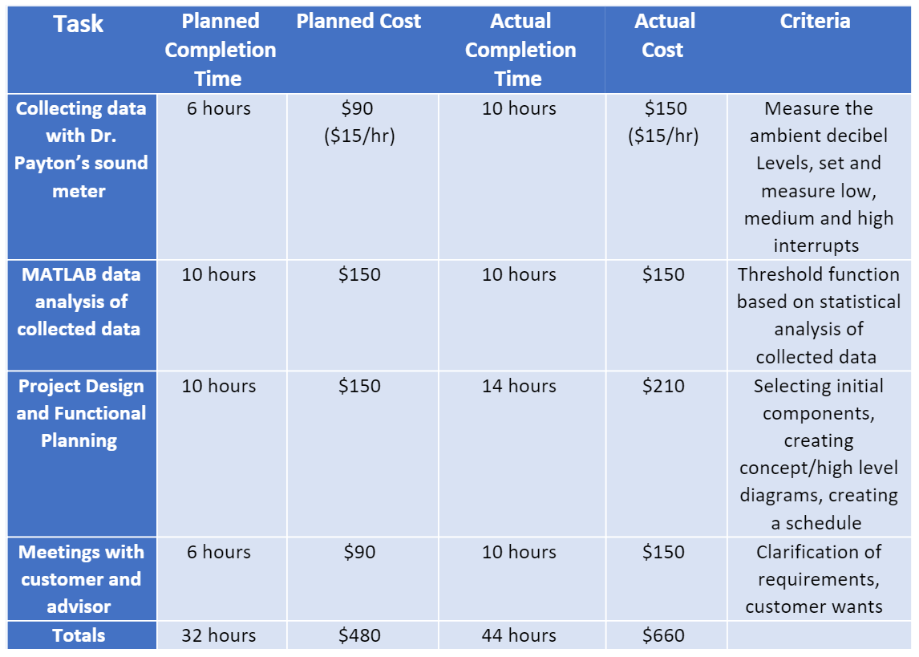
Earned Value Assessment

